Slide 1

Gaussian Mixture Models (GMM)
16102284 Lee SungHo
▶▶

Slide 2
High Tech Marketing
Contents
▶▶
1
Pre-knowledge
Probability vs Likelihood
Maximum Likelihood Estimation
2
GMM
Problems before the introduction of GMM
EM Algorithm
3
Example of using GMM
Economic value analysis
Outlier detection

Slide 3
High Tech Marketing - Pre-knowledge
1.1 Probability vs Likelihood
▶▶
Likelihood can be seen as the y value of the probability distribution function corresponding to a specific event. In the case of countable events such as tossing coins or rolling dice, the y-value indicates the probability of each event, so the likelihood is possible. In the case of a continuous event, the y value is the pdf value (not the width, but the y value), so the likelihood is the pdf value corresponding to the specific event x.
 | Probability | Likelihood
Countable(1~6 Dice) | The probability of getting 2 is 1/6. | The probability of getting 2 is 1/6.
Uncountable(1~6 Real Num) | The probability of getting 2 is 1/ inf, that is, zero. | The probability of being between 2 and 3, that is 1 / 5

Slide 4
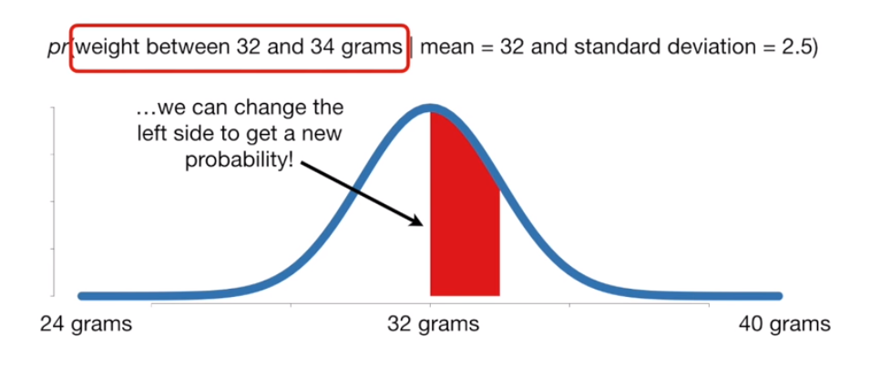
High Tech Marketing - Pre-knowledge
1.2 Maximum Likelihood Estimation
▶▶
MLE is the process of finding parameters that maximize the likelihood of continuous probability variables. In the probability density function, parameter θ is a known constant coefficient and x is a variable, but in the likelihood function, parameter θ is the variable, and the sample value x is considered a constant coefficient.

Slide 5
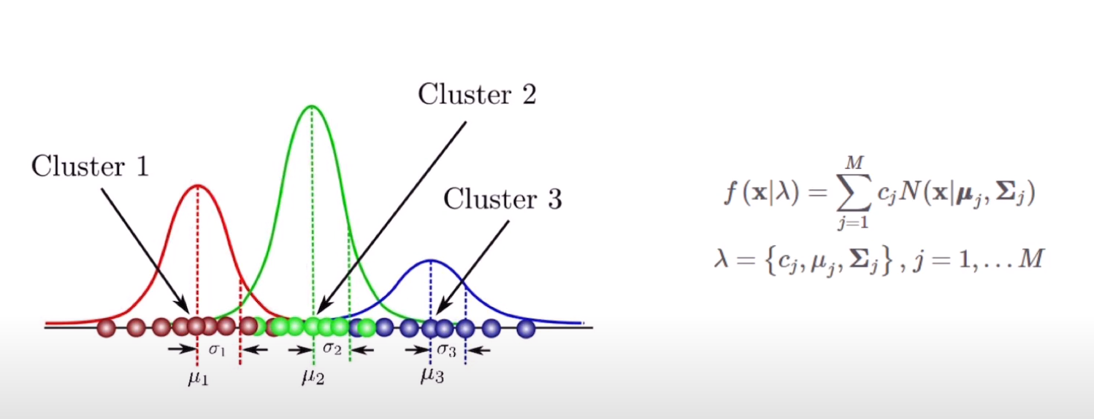
High Tech Marketing - GMM
2. GMM
▶▶
A model that expresses data as a weighted sum of M Gaussian distributions.
The parameters you want to find are the mean, covariance, and weigh of each normal distribution.
Optimization using Expectation-Maximization algorithm in training

Slide 6
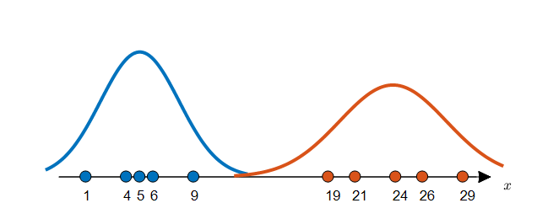
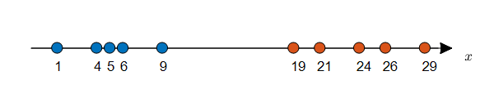
High Tech Marketing - GMM
2.1 Problems before the introduction of GMM
▶▶
<Data given a label and two distributions estimated on it>

Slide 7
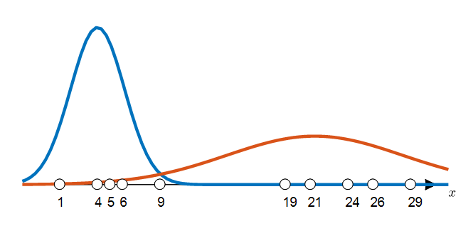
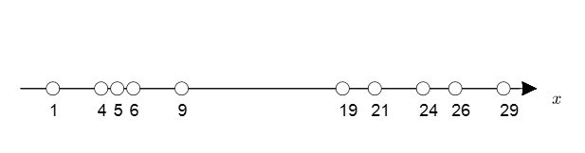
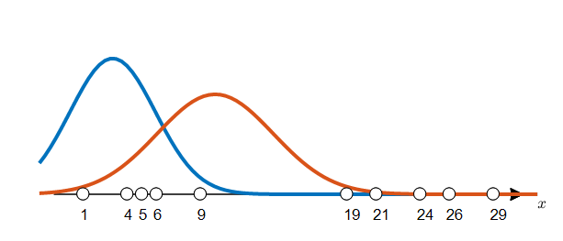
High Tech Marketing - GMM
2.1 Problems before the introduction of GMM
▶▶
<Multiple distributions that unlabeled data can have>

Slide 8
High Tech Marketing - GMM
1.2 Maximum Likelihood Estimation
▶▶
To get a label, it needs a distribution,
and to get a distribution, it needs a label.
Clustering is repeatedly performed by giving a parameter at random, obtaining a label, and using the label to obtain a distribution again.

Slide 9
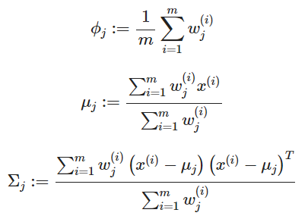

High Tech Marketing - GMM
2.2 Expectation-Maximization (EM)
▶▶
(E - step) For each i,j, set
(M - step) Update the parameters
i means the order of data
j means the label,
x(i) means the i-th dataset
z(i) means the label of the i-th dataset.
Data ratio between groups (weigh)
μj는is the average value of group j
Σj the standard deviation or covariance matrix.

Slide 10
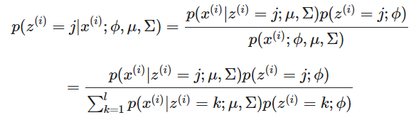
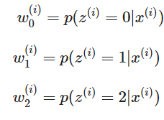
High Tech Marketing - GMM
2.2 Expectation-Maximization (EM)
▶▶
= a
= b
= c
a+b+c=1
This step, (weigh, mean, covariance) are given parameter values!
E Step: Calculate the probability that the data belong to each Gaussian distribution through the estimated parameters

Slide 11
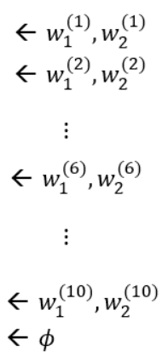
High Tech Marketing - GMM
2.2 Expectation-Maximization (EM)
▶▶
 | The probability of belonging to each group
 | Group1 | Group2
Data1 | 0.93 | 0.07
Data2 | 0.80 | 0.20
Data3 | 0.70 | 0.30
Data4 | 0.57 | 0.43
Data5 | 0.14 | 0.86
Data6 | 0.00 | 1.00
Data7 | 0.00 | 1.00
Data8 | 0.00 | 1.00
Data9 | 0.00 | 1.00
Data10 | 0.00 | 1.00
Mean | 0.32 | 0.68
M Step: Update the parameter (λ) for Gaussian distribution based on the probability that the data belongs to each distribution
Notes:
sdsadasd

Slide 12
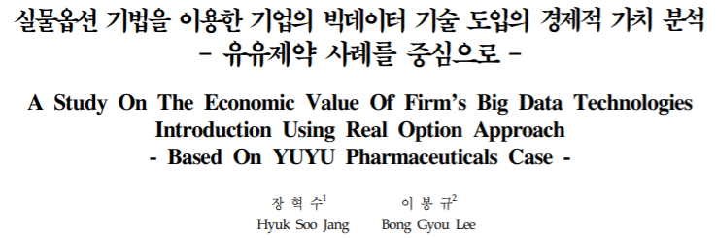
High Tech Marketing - Example of using GMM
3.1 Economic value analysis
▶▶
Analyze the size of the economic value evaluated by stock price increment using the stock price of the company that decided to introduce big data technology through option value
Extract the stock price increment by big data technology from the stock price of a company that used big data technology for marketing to derive option value
Estimate the probability process using the generalized moment method (GMM) with the corresponding stock price
Result: In addition to the effect of generating actual corporate profits, it is interpreted that the introduction of big data technology has an insignificant but additional time value that can be considered at the time of investment.

Slide 13
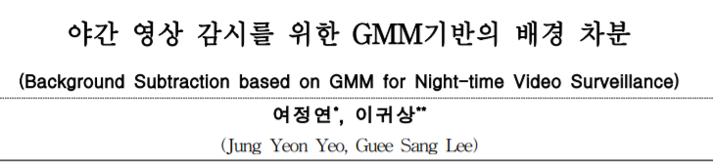
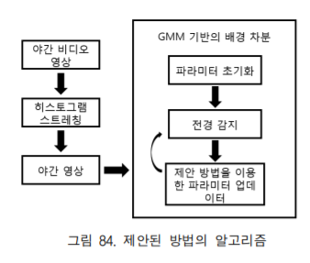
과
High Tech Marketing - Example of using GMM
3.2 Outlier detection
▶▶
When learning GMM with normal data
When normal data is input, f(x|λ) increases
When abnormal data is input, f(x|λ) decreases
Take advantage of the property that outliers are located in regions of low probability density
Background subtraction method using background modeling based on GMM (Gausssian mixture model) specialized for night-time video surveillance
To find the most ideal background using the adjusted pixel values, the GMM-based background modeling method is applied in units of pixels.
Instead of removing the low-weighted Gaussian, the existing accumulated information is considered by using the difference between the average of the existing Gaussian and the input pixel value and applying it to the new average.

Slide 14

High Tech Marketing
▶▶

